Slide 1
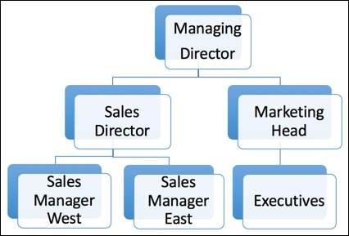
When OWD is Private. How to open access?
Role hierarchy
Salesforce allows us to control the records access and organization reports using role. In other words, you can use it to control record-level access in Salesforce.
Users who are higher in the role hierarchy will be able to see the records of people below them. Users who share the same the role or who are at the same level cannot access each other's records:

